Slide 1


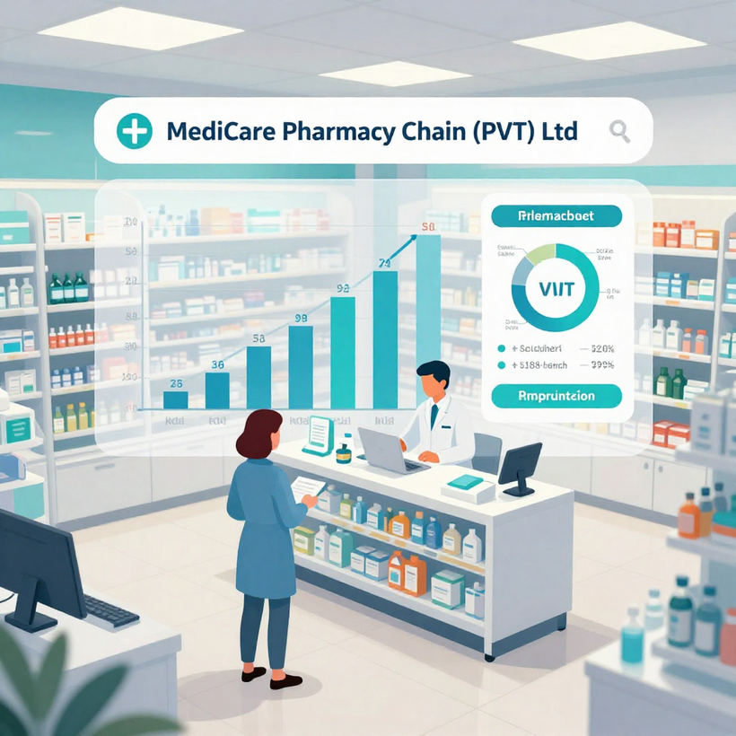

IMPLICATIONS OF USING DATA AND INFORMATION in MediCare Pharmacy Chain (PVT) Ltd
Presented By: Afry Nizam 1001953
Role: Junior Business Process Support Analyst
Organization: MediCare Pharmacy Chain (PVT) Ltd
Unit: Business Process Support

Slide 2



Introduction
Modern business operations uses data support
MediCare uses customer prescription data
Data creates ethical responsibilities
Security risks effect business data
Data impacts business performance

Slide 3



Social Implications
Patient data must stay private
Customers expect secure data handling
Data misuse reduces customer trust
Security improves customer confidence

Slide 4
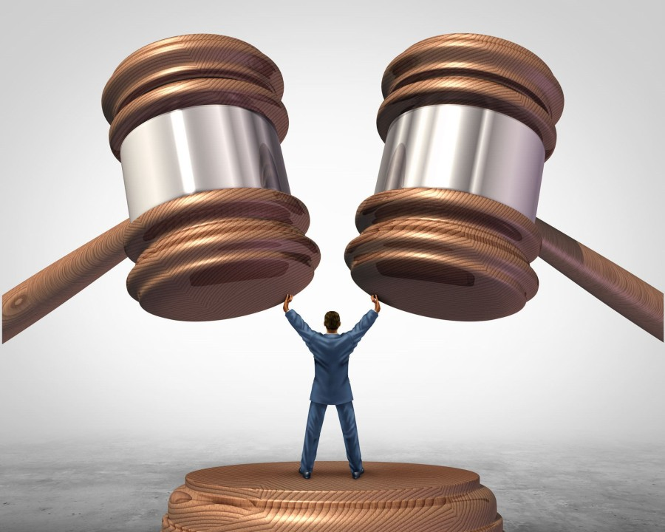

Legal Implications
Organizations must follow data laws
Patients data need legal protection
Unauthorized sharing causes legal penalties
Healthcare privacy regulations must be followed
Compliance protects company reputation

Slide 5


Ethical Implications
Data must be used responsibly
Customer permission is very important
Staff must respect customer privacy
Ethical use improves company reputation

Slide 6




Common Data Threats
Cyber criminals target sensitive data
Data theft causes financial losses
System failures cause data loss
Human errors increase security risks
Threats affect business performance

Slide 7

Common Data Threats
Data Breaches
Malware damages computer systems
Ransomware locks important files
Viruses delete valuable patients data
System failures cause unexpected data loss
Data loss effects business operations
Malware and Data Loss
Confidential data may be stolen
Weak passwords increase breach risks
Hackers steal customer personal details
Breaches damage company reputation
.

Slide 8


Personal Security Measures
Use strong secure passwords always
Avoid opening suspicious email attachments
Install antivirus on personal devices
Follow company security guidelines strictly
Attend regular security awareness training

Slide 9

Organizational Security Measures
Install firewalls and antivirus software
Use secure login access systems
Encrypt sensitive customer prescription data
Maintain regular system data backups
Monitor security systems continuously

Slide 10


.
Backup and Recovery
Backup systems protect important data
Regular backups ensure quick recovery
Cloud storage provides secure backup
Recovery supports business continuity

Slide 11



Data Supports Decisions
Sales data shows medicine demand
Inventory data controls stock levels
Prescription data supports patient safety
Planning becomes faster and reliable

Slide 12

Operational Performance
Automation reduces manual human errors
Faster system improves customer service
Monitoring prevents expired medicine sales
Efficiency increases staff productivity
.

Slide 13

Wider Implications
Secure systems improve company reputation
Legal compliance reduces penalty risks
Data supports long-term business growth
Responsible use ensures business sustainability

Slide 14

Conclusion
Legal ethical responsibilities must follow
Many threats exist to data
Security measures protect organizational systems
Data improves performance and decisions

Slide 15

Thank You!
Stay Safe, Stay Smart

